Slide 1
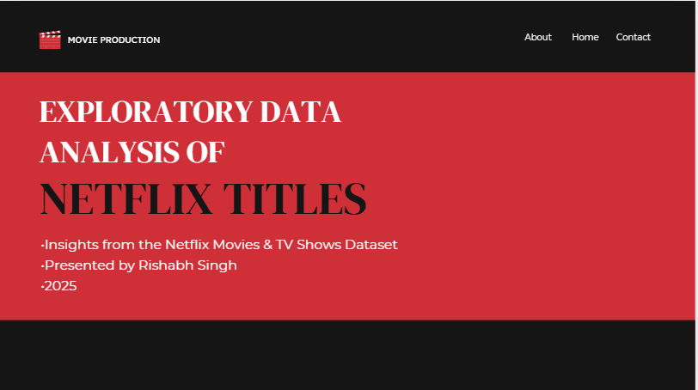

Slide 2



MOVIE PRODUCTION
About
Home
Contact
INTRODUCTION
• Netflix is a leading streaming platform.
• Dataset covers movies & TV shows.
• Includes title, type, country, rating, genre, release year, date added.
• Goal: Extract patterns and insights

Slide 3

MOVIE PRODUCTION
About
Home
Contact
DATASET OVERVIEW
• Contains ~8,800 titles.
• Key fields: type, director, cast, country, rating, duration, genres.
• Data cleaned and dates standardized.

Slide 4
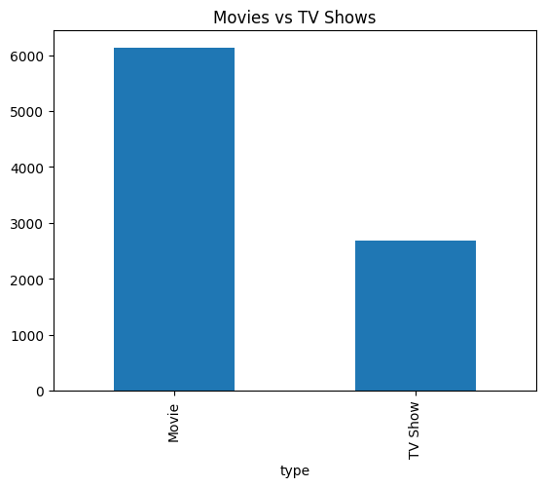
MOVIE PRODUCTION
About
Home
Contact
CONTENT TYPE DISTRIBUTION
•Movies ~70–75% of catalog.
• TV Shows ~25–30%.
• Netflix focuses more on movies but invests heavily in series.

Slide 5
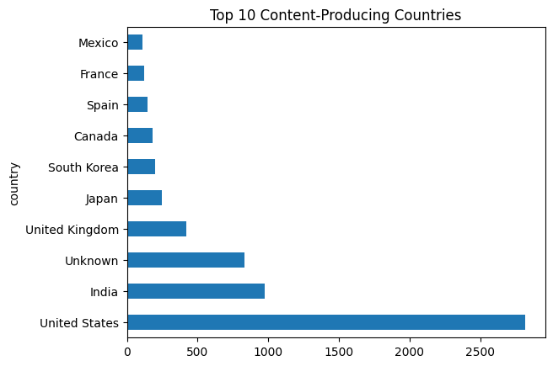
MOVIE PRODUCTION
About
Home
Contact
COUNTRY-WISE INSIGHTS
• Top producing countries: USA, India, UK, Canada, Japan.
• Indicates strong global production diversity.

Slide 6
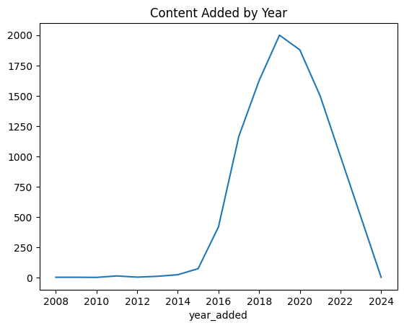
MOVIE PRODUCTION
About
Home
Contact
RELEASE YEAR TRENDS
• Steady growth from 2000–2020.
• Major spike around 2018–2020.
• Growth driven by Netflix Originals.

Slide 7
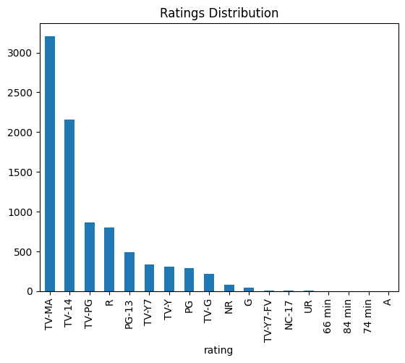
MOVIE PRODUCTION
About
Home
Contact
RATINGS DISTRIBUTION
•• Most common: TV-MA, TV-14, TV-PG.
•• Majority of content aimed at mature audiences.

Slide 8
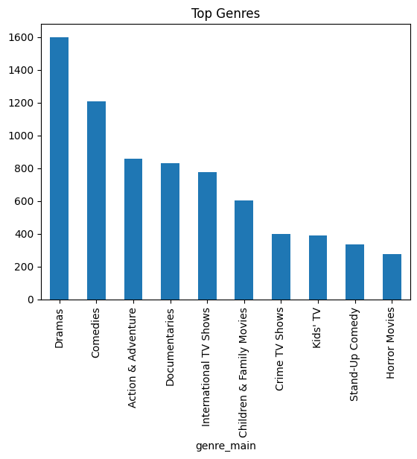

MOVIE PRODUCTION
About
Home
Contact
GENRE ANALYSIS
•• Top genres: International Movies, Dramas, Comedies, Documentaries.
•• Shows wide content diversity.

Slide 9
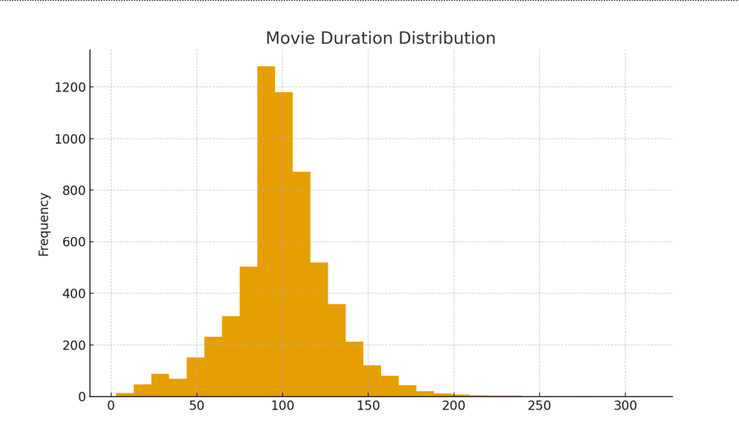
MOVIE PRODUCTION
About
Home
Contact
DURATION INSIGHTS
•• Movies mostly 80–120 minutes.
•• TV shows usually 1–2 seasons.
•• Indicates preference for binge‑friendly formats.

Slide 10
MOVIE PRODUCTION
About
Home
Contact
CONCLUSION
• Netflix catalog is movie‑dominant.
• High content production from USA & India.
• Strong growth in yearly additions.
•• Diverse genres & mature‑audience focus.

Slide 11

MOVIE PRODUCTION
About
Home
Contact
THANK FOR YOUR ATTENTION

